Slide 1
PHASE 1 PROJECT
PANTHERA ACTIVATED CARBON
TOOL SEARCH PAGE

Slide 2
INTRODUCTION
Motivation:
The company where I work, there is tools theft going on. Because I have some software developer skills, I challenged myself to develop an app quickly to aid in tracing the number of tools in the store.

Slide 3
STEPS
Design the APP layout page
Use a JSON file to list the tools according to
Use JavaScript to enable the user(store clerk) to:-
  Display the tools in the layout page
  Add new tools
  Update the number of tools
  Delete a tool (in future: I should be able to put a security feature to this)

Slide 4
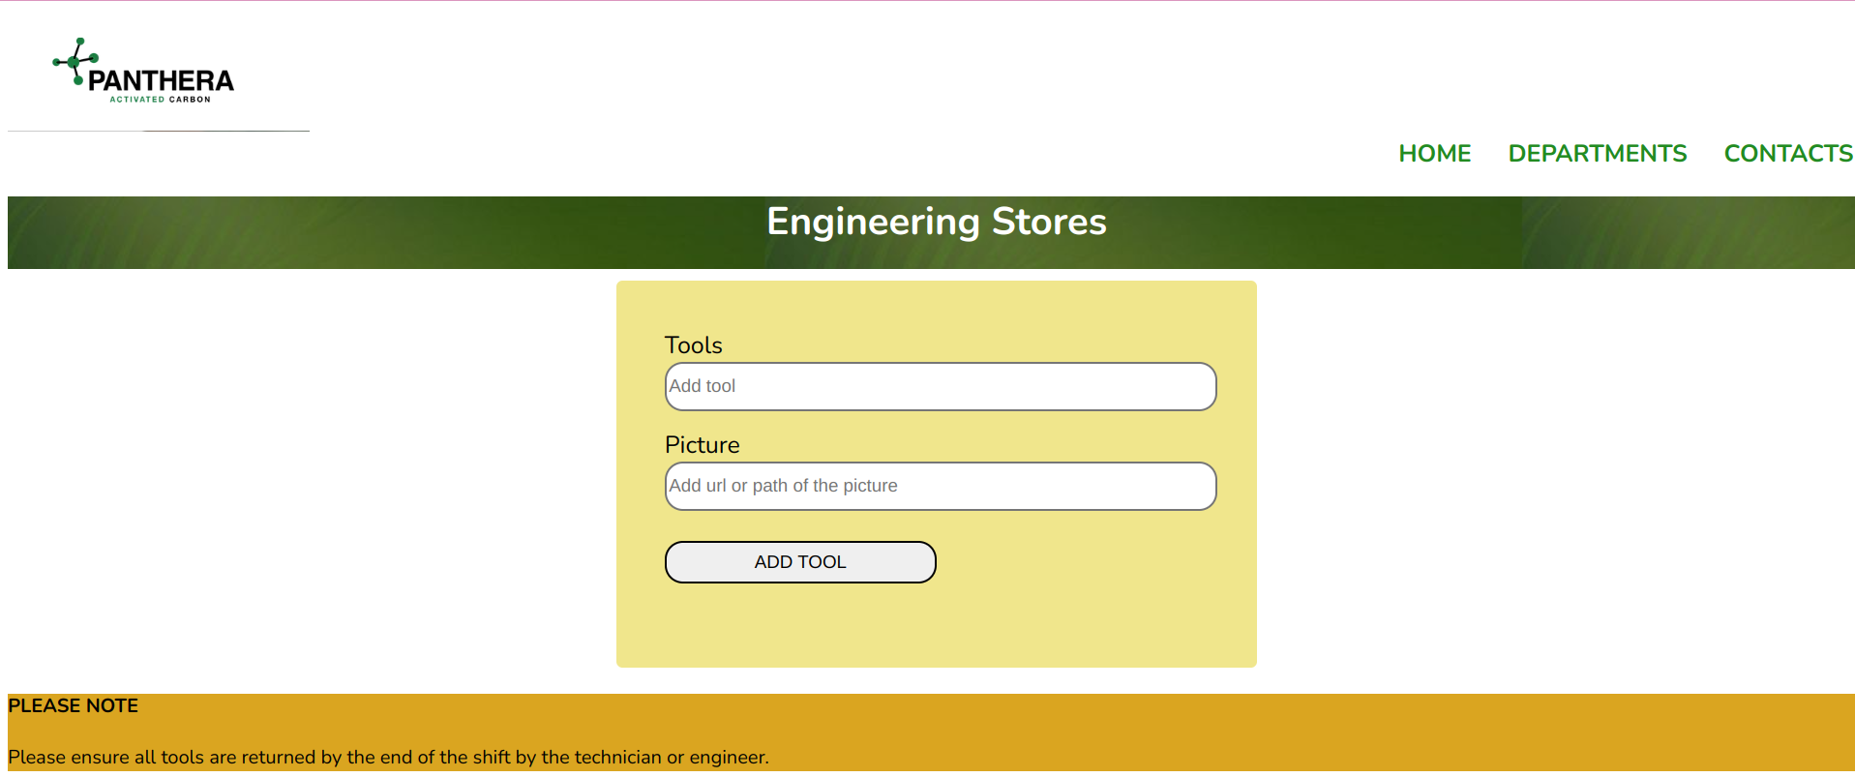
APP LAYOUT

Slide 5
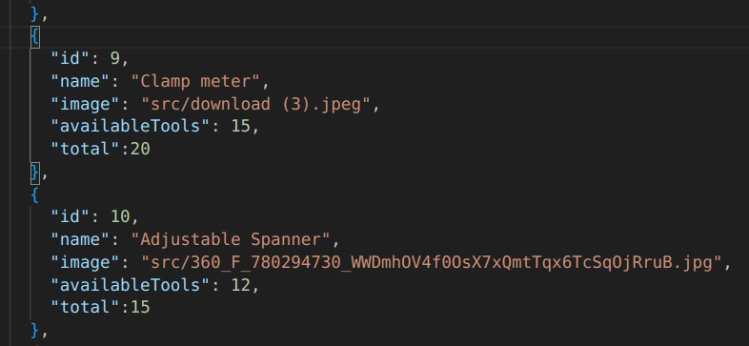
API LAYOUT

Slide 6
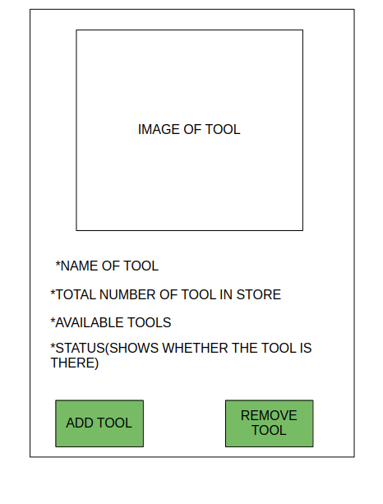
DISPLAY

Slide 7


